Slide 1
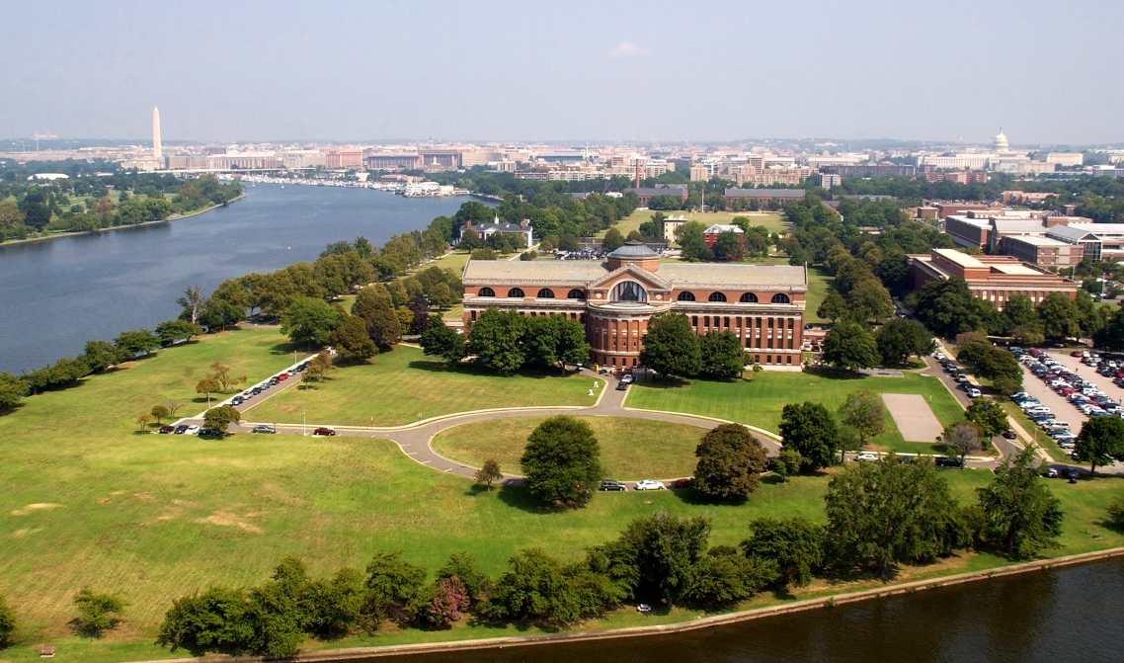
Joint Education Transformation Initiative
NATIONAL DEFENSE UNIVERSITY
Board of Visitors
Special Meeting 14 March 2014
THE CHAIRMAN’S UNIVERSITY

Slide 2
Why Transform?
“Education is a fundamental pillar of
leader development, but … education is only part of the solution”
CJCS Guidance Memo 28 June 2013
As we continue to advance “One University” [whole-of-NDU] initiatives at National Defense University, we will update the joint PME curriculum across the force to emphasize key leader attributes. We will also explore how best to adapt our learning institutions to serve a global Joint Force, evaluating degree accreditation and distance-learning delivery methods.
-18th Chairman’s 2nd term Strategic Direction to the Joint Force
Strategic Leadership
Education
Training
Professional Experience
Resiliency
Lessons to be Learned from War
JPME II
Character, Ethics, Profession of Arms

Slide 3
What Transforms?
Strategic Plan Goal 4:
National Defense University evolves and reforms the processes, practices, structures, organization, and culture to foster institutional collaboration and integration.
Student-centric
Better Integration on Leader Continuum
Common Academic Calendar
University Approach to Curriculum Development

Slide 4
2014-15 Delivery Changes
Engaging
students
before arrival
Planning & Assessment
Develop the individual student assessment and learning plan
6 weeks
27 weeks
8 weeks
Phase 1: Strategic Leader Foundational Course
Phase 2: College Core Curricula
Cyber (iCollege)
Irregular Warfare/CT (CISA)
Joint Campaign Planning (JFSC)
National Security (NWC
Resourcing & Acquisition Strategy (ES)
Phase 3: Tailored Leader Development
Electives
Capstone Project
Common Academic Calendar
Planning & Assessment
• Empirical feedback from students, faculty and customers
for continuous program improvement
• Graduate life-long learning plan development
Engaging
graduates

Slide 5
BACK UP SLIDES

Slide 6
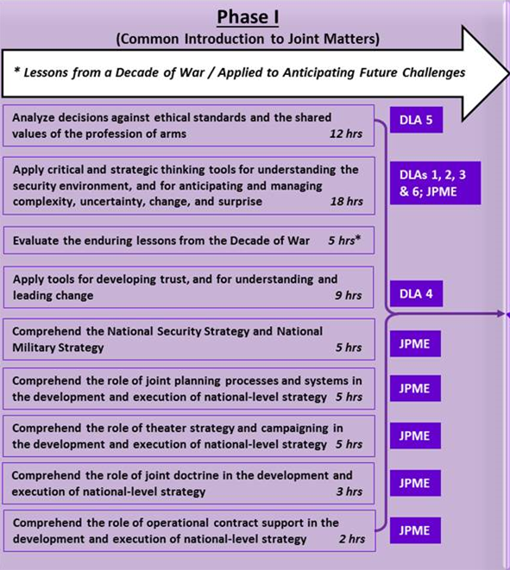
Phase I: Strategic Leader Foundational Course

Slide 7
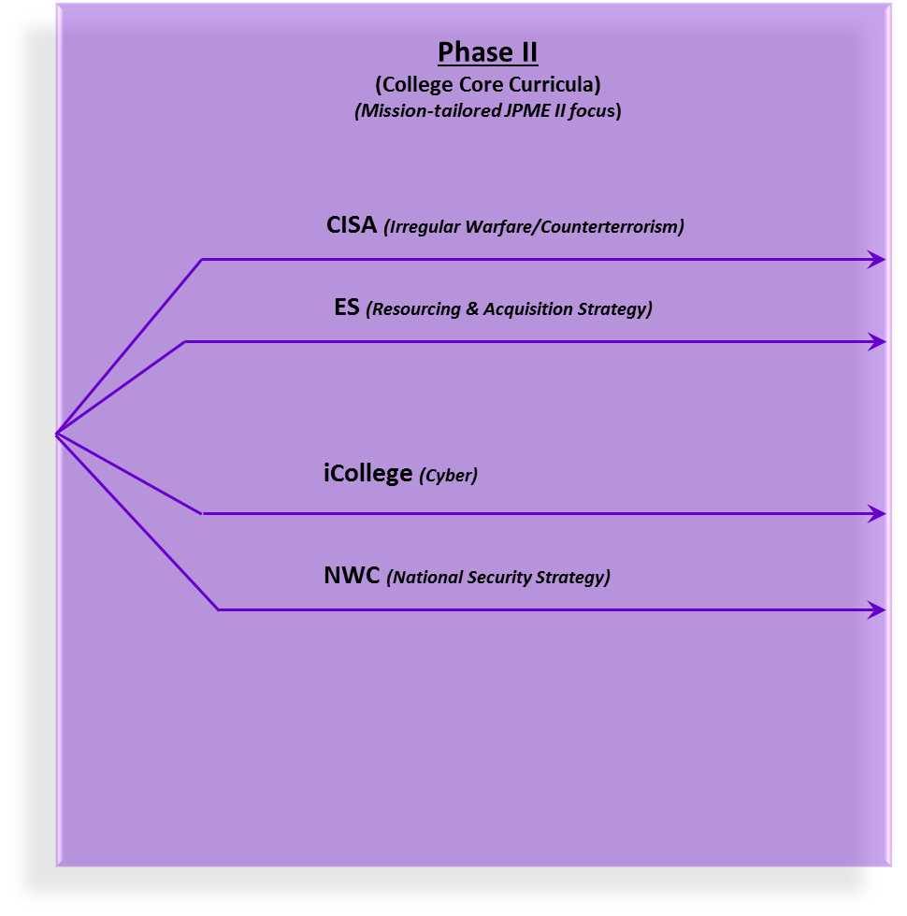
Phase II: College Curricula

Slide 8
Desired Leader Attributes
A strategic leader will demonstrate:
#1 - The ability to understand the security environment and the contributions of all instruments of national power
#2 - The ability to anticipate and respond to surprise and uncertainty
#3 - The ability to anticipate and recognize change and lead transitions
#4 - The ability to operate on intent through trust, empowerment, and understanding (mission command)
#5 - The ability to make ethical decisions based on the shared values of the Profession of Arms
#6 - The ability to think critically and strategically in applying joint warfighting principles and concepts to joint operations
CJCS Notice 3500.01, 10 OCT 2013

Slide 9
Individual Student Research Project (ISRP)
U.S. Students with Bachelor’s enter Master’s Program at College
Culminating ISRP
Tailored by College mission and core curricula
Culmination of research and analysis
Students will brief and defend results
Students supervised by faculty
Two forms
Academic thesis
Report of solution to a contemporary problem

Slide 10
Strategic Plan Framework
Vision
NDU will be the premier National Security Institution for advanced joint education, leader development, and scholarship
Values
Strategic Intent
Mission
NDU supports the joint warfighter by providing rigorous Joint Professional Military Education to members of the U.S. Armed Forces and select others in order to develop leaders who have the ability to operate and creatively think in an unpredictable and complex world.
Academic Excellence
Academic Freedom
Collaboration
Diversity
Holistic Development
Integrity
Evolve into One University marked by preeminence and collegiality across the institution
Enable continual institutional renewal and improvement
Leverage and integrate best practices to produce synergy, alignment and excellence
Education and Leader Development: Educates, develops and inspires national security leaders
Scholarship: Creates, preserves, and disseminates knowledge
University Improvement: Evolves to foster institutional collaboration and integration
Strategic Goals
Institutional Enablers: Creates integrated solutions and services
Imperatives
Advanced joint education and supporting programs
Joint student body of national security professionals
Students meet graduate education performance standards
Joint faculty of scholars
Faculty engaged in knowledge ceration and dissemination

Slide 11
Strategic Plan Framework
Goal
Education and Leader Development:
Educates, develops, and inspires national security leaders
Goal
Scholarship:
Creates, preserves, and disseminates knowledge
Goal
Institutional Enablers:
Creates integrated solutions and services
Academic programs enable graduates to lead effectively in a rapidly changing global security environment.
Values and promotes scholarship to drive leader development for national and international security.
Workforce is recognized for excellence in thought leadership and their profession.
Leads in the transformation/evolution of joint professional military education for 2020 and beyond.
Graduates employ innovative, critical, open, and systems thinking.
Fosters a reputation for excellence in scholarship that attracts and retains a highly effective faculty and staff of national and international prominence.
Develops and maintains an open, inclusive, and transparent educational environment of enterprise-wide collaboration, academic freedom, and diversity that supports the pursuit of excellence in scholarship.
Promotes awareness of, and access to, NDU scholarship and expertise across the institution and key stakeholders.
Allocates and manages resources effectively, efficiently, and transparently to achieve excellence in mission success.
Information and educational technology resources systems are integrated, robust, accessible, and enterprise-wide.
Library and information resources are integrated, robust, accessible, and enterprise-wide.
Goal
University Improvement:
Evolves/ Reforms to foster institutional collaboration and integration
Values and promotes an institutional environment and culture of trust and openness.
Continually pursues institutional and academic excellence via institutional improvement and renewal.
PRESENTERS NAME
DATE

Slide 12
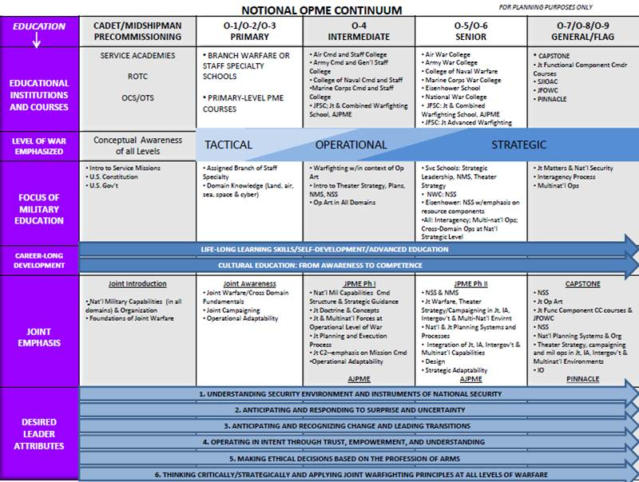
Joint Education Review OPMEP Concept

